Slide 1
Lineup Changes: 2018 Edition

Slide 2
You know the routine. Make the changes on your lineup card, (if legal).

Slide 3
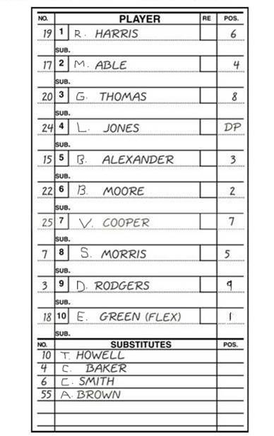
6
4 goes in for 7.
6 goes in for 19.
7 re-enters for 15.
(No)
7 re-enters for 4.
10 courtesy runs for 22 (3rd inning).
10 courtesy runs for 22 (4th inning).
Flex goes in for DP.
DP re-enters.
19 re-enters.
6 re-enters
Etc, etc.
6
x
4
7
C3
,4

